Slide 1


5th Semester DBMS Mini Project
RETAIL DATABASE MANAGEMT SYSTEM
PRESENTED BY:
VARUN K S (1DB19IS101)
GUIDED BY:
Mrs. Rohini B.R
Asst. Professor
Department of ISE
DBIT
GUIDED BY:
Mrs. Basavaraj Neelagund
Asst. Professor
Department of ISE
DBIT
Department of Computer Science and Engineering
Don Bosco Institute of Technology, Mysore road, Kumbalagodu,Bangalore

Slide 2
AGENDA
INTRODUCTION
ABSTRACT
AIM AND OBJECTIVE
ER DIAGRAM
SCHEMA DIAGRAM
CONCLUSION
REFERENCE

Slide 3
INTRODUCTION
Bus Management System developed using PYTHON is an excellent solution for travel companies having with a large number of buses and growing number of pasangers to travel day by day.
In its working, the companies can manage their buses ,the can access the bus details of any bus and know there information only buy unique number called bus number similarly they can access the data of any passenger by the booking number of the and payments by the transaction id ,they can also insert ,delete ,update the details of the bus or passengers details
Hence, this makes the travel companies easier to maintain the data without any problem or in manual way and make it easy to see and search the details required .

Slide 4
ABSTRACT
The major purpose of this recommendation system is to facilitate connection between the students and resources available on the internet .It provides a platform for the users to know about the resources , examples and ready codes available on the internet and also the tutorial videos available on you-tube.
To use this application, the user must first register (signup) into the system and then is eligible to check out the contents of the website. The database handles user registration, login, logouts and sign-outs of user. It also handles admin login and he has the privilege to monitor entire database operation like updating a courses to database, deleting the user accounts . .
Thus ,the online course recommendation project brings the students and internet resources for the students on step closer by providing easy access to students in knowing the contents that are there on the internet ,so that the students can learn faster and smarter.

Slide 5
AIM AND OBJECTIVE
Aim
The main aim of designing this project is to get rid from manual entry and record system and try to give easy and simple database management system for bus management.
Objective
The main objective of this DBMS mini project is to construct good quality and dynamic management system, in which this database is used to store the details of buses, staff, reservation, passenger and payments .

Slide 6
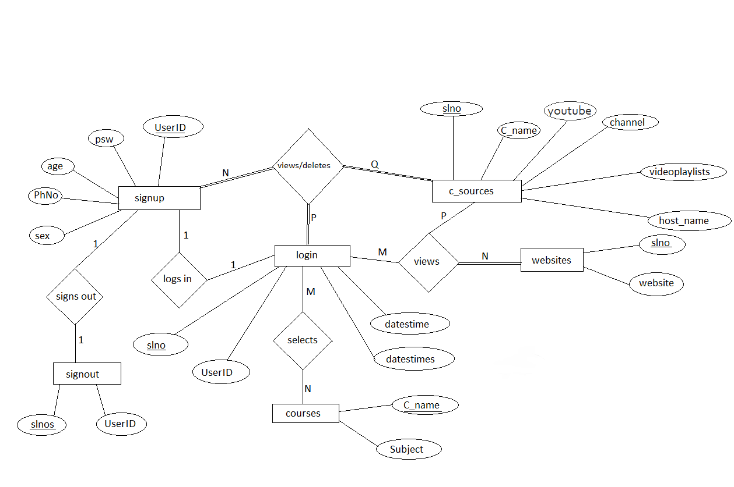
ER DIAGRAM

Slide 7
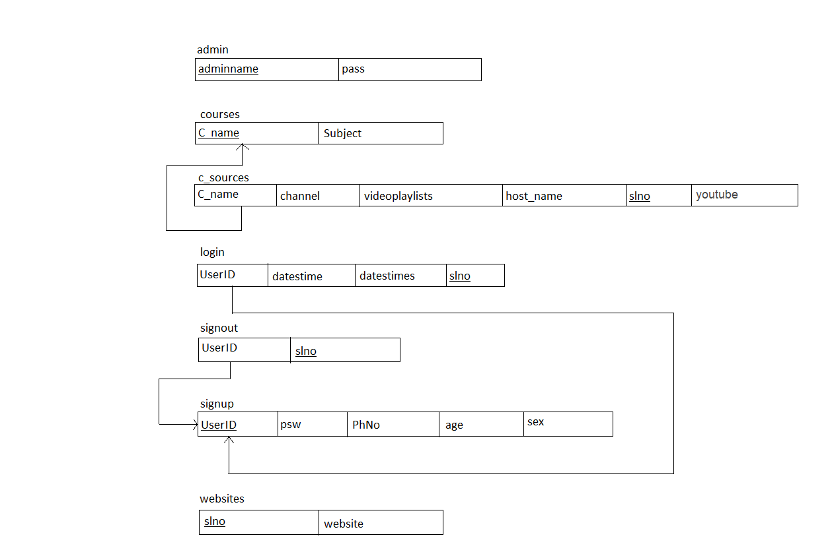
SCHEMA DIAGRAM

Slide 8
CONCLUSION
The Mini Project “Online Course Recommendation” is designed in order reduce the burden of maintaining bulk of records of course details in which Inserting, Retrieving and updating the Details are easy when itis compared to the manual update and storing. This project helps in maintaining the courses details in an Organized manner and to replace old paper work system.
While developing this mini project we have learnt a lot about php/MySQL and working with database management, we have also learnt how to make the application user friendly (easy to use and handle) by hiding the complicated parts of it from the users.
Using MySQL as the database is highly beneficial as it is free to download, popular and can be easily customized. The data stored in the MySQL database can easily be retrieved and manipulated according tothe requirements with basic knowledge of SQL.
With the theoretical inclination of our syllabus it becomes very essential to take the at most advantage of any opportunity of gaining practical experience that comes along. The building blocks of this Major Project “Online Course Recommendation” was one of these opportunities. It gave us the requisite practical knowledge to supplement the already taught theoretical concepts thus making us more competent as a computer engineer. The project from a personal point of view also helped us in understanding the following aspects of project development:
2.3 The planning that goes into implementing a project.
2.4 The importance of proper planning and an organized methodology.
2.5 The key element of team spirit and co-ordination in a successful project.

Slide 9
REFERENCE
Website :
https://dev.mysql.com/doc/
https://www.wikipedia.com
https://www.w3schools.com/sql*

Slide 10
Thank You

